Slide 1
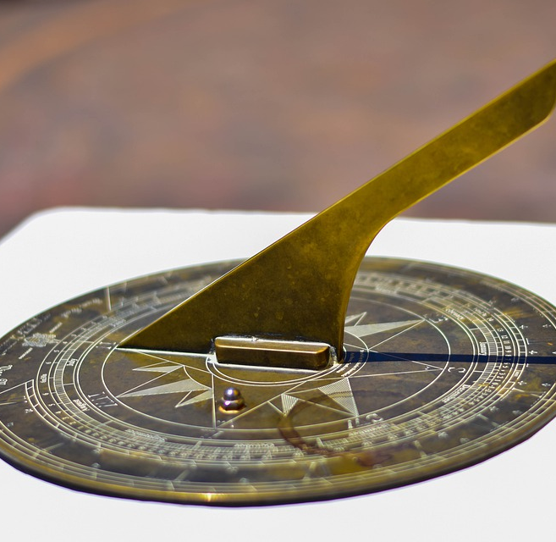
Project Sundial
A 3D Interface for Energy Meter Data
Built on Circaevum

Slide 2
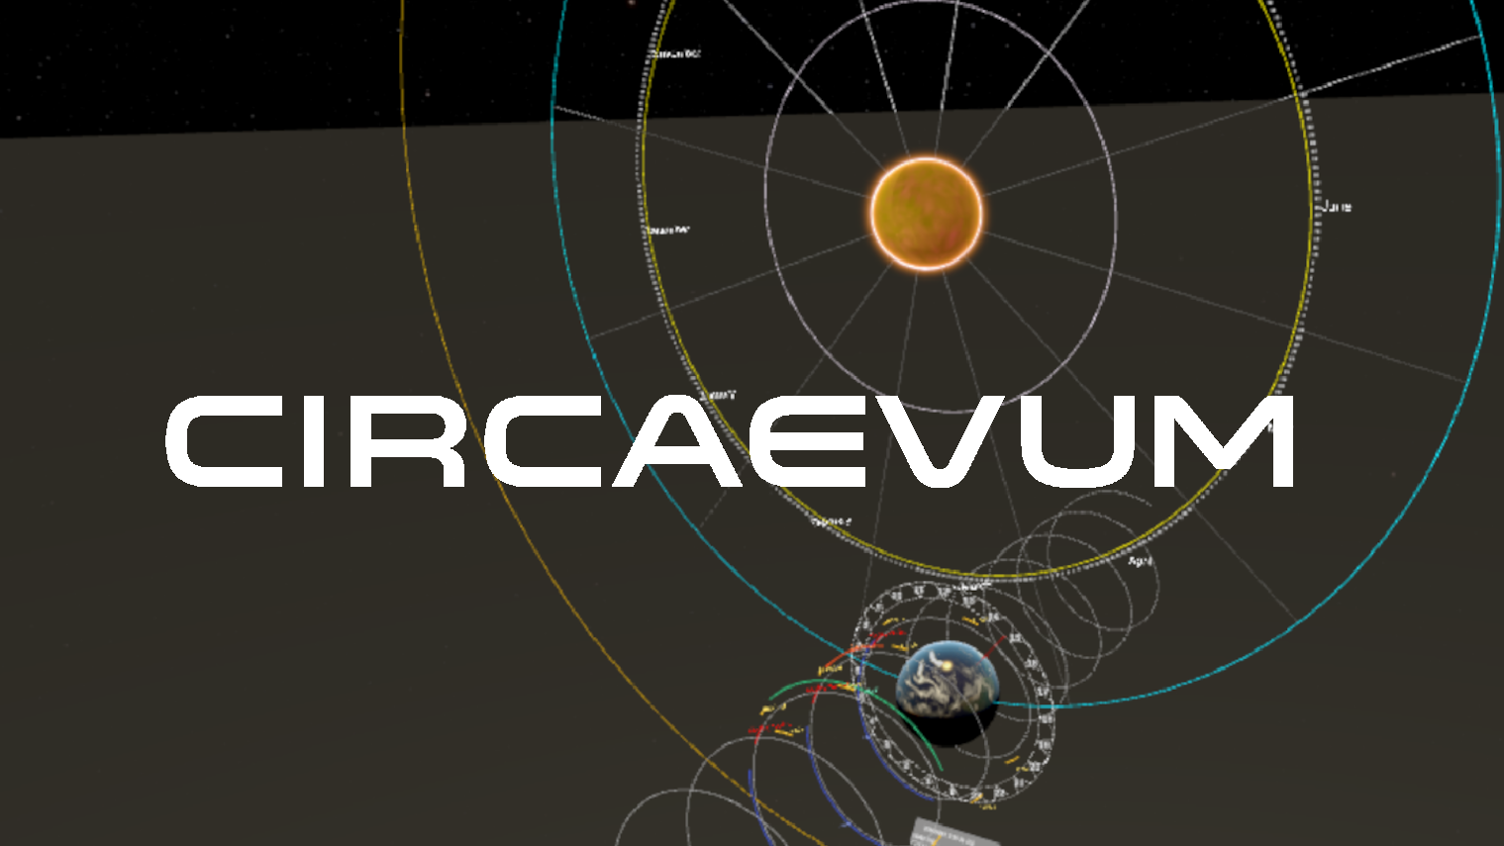
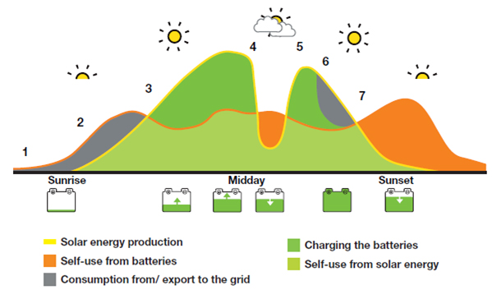
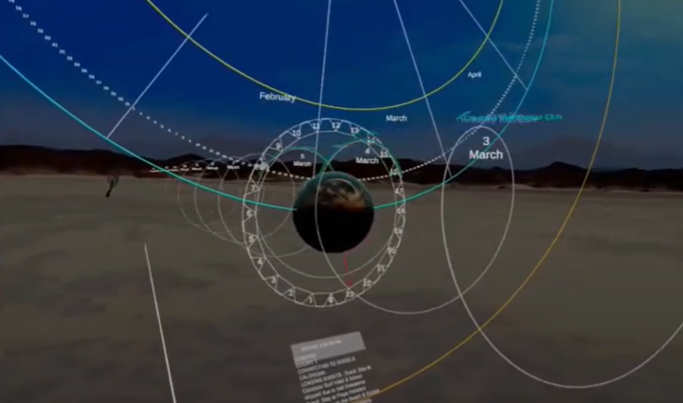
Outline
1. Background 2. Energy Meter Data 3. Sundial
+
=

Slide 3
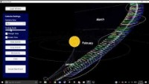
Circaevum
A 3D General-Purpose Calendar System
- Modeled after the Earth’s orbit around the Sun
Maps events based on timespan and location
Visual place to aggregate time-based data
Built in Game Engine = Deployable to multiple platforms
PC
Mobile
VR
Game Console
Web

Slide 4
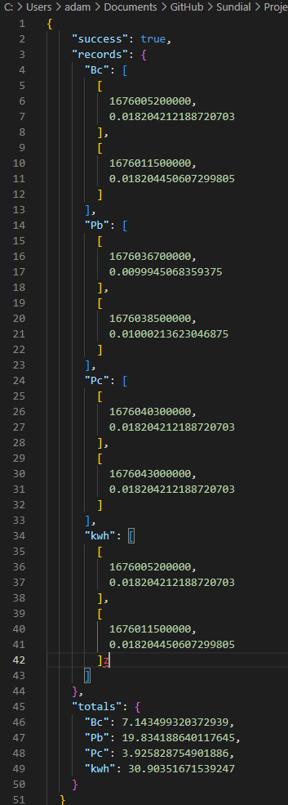
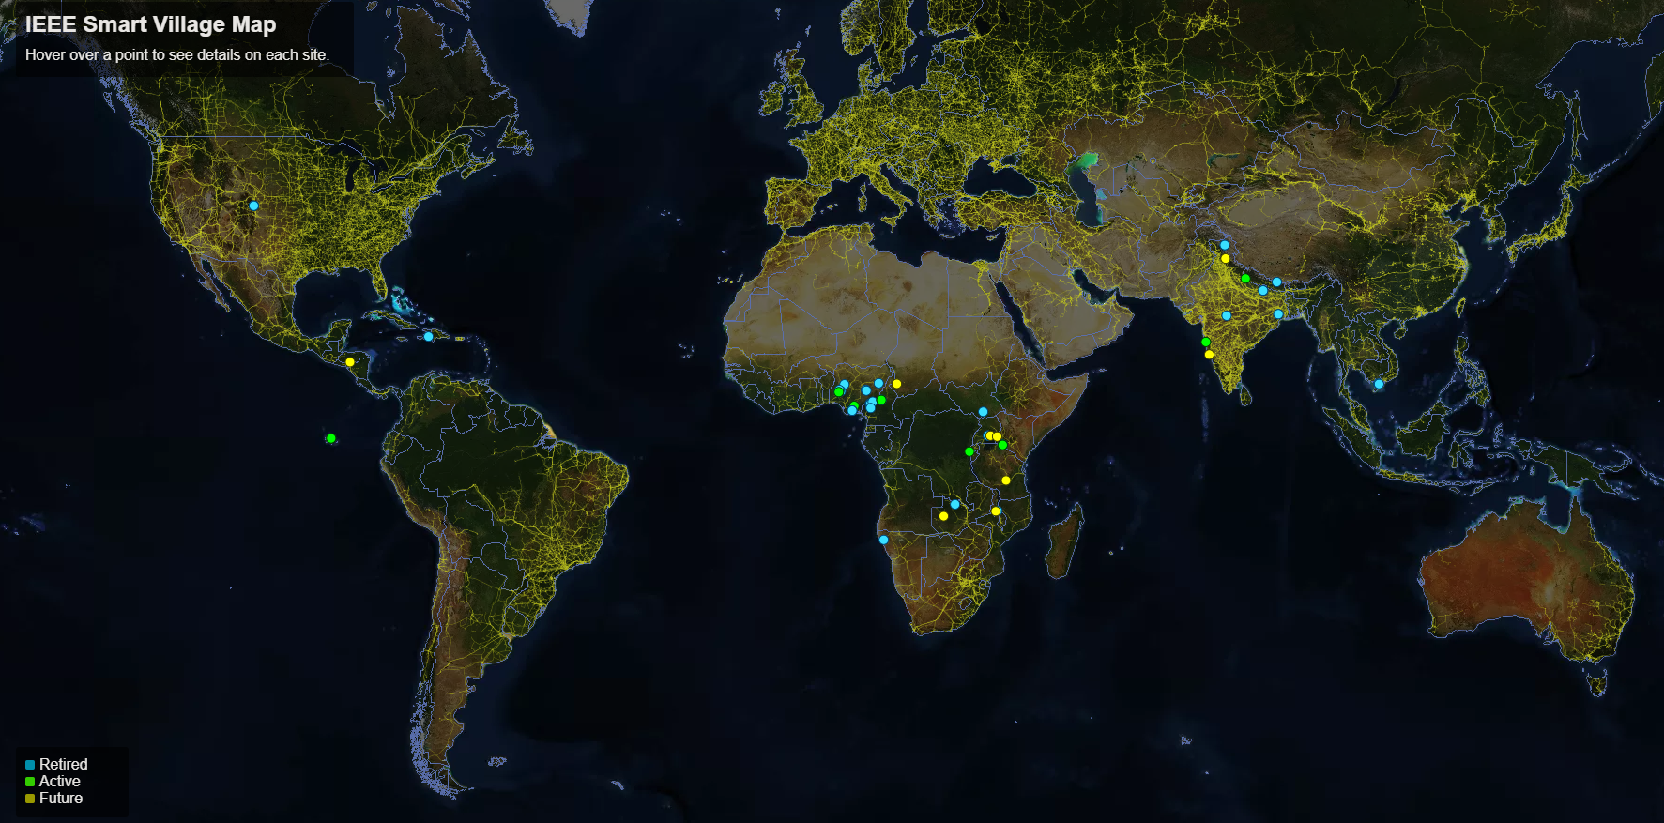
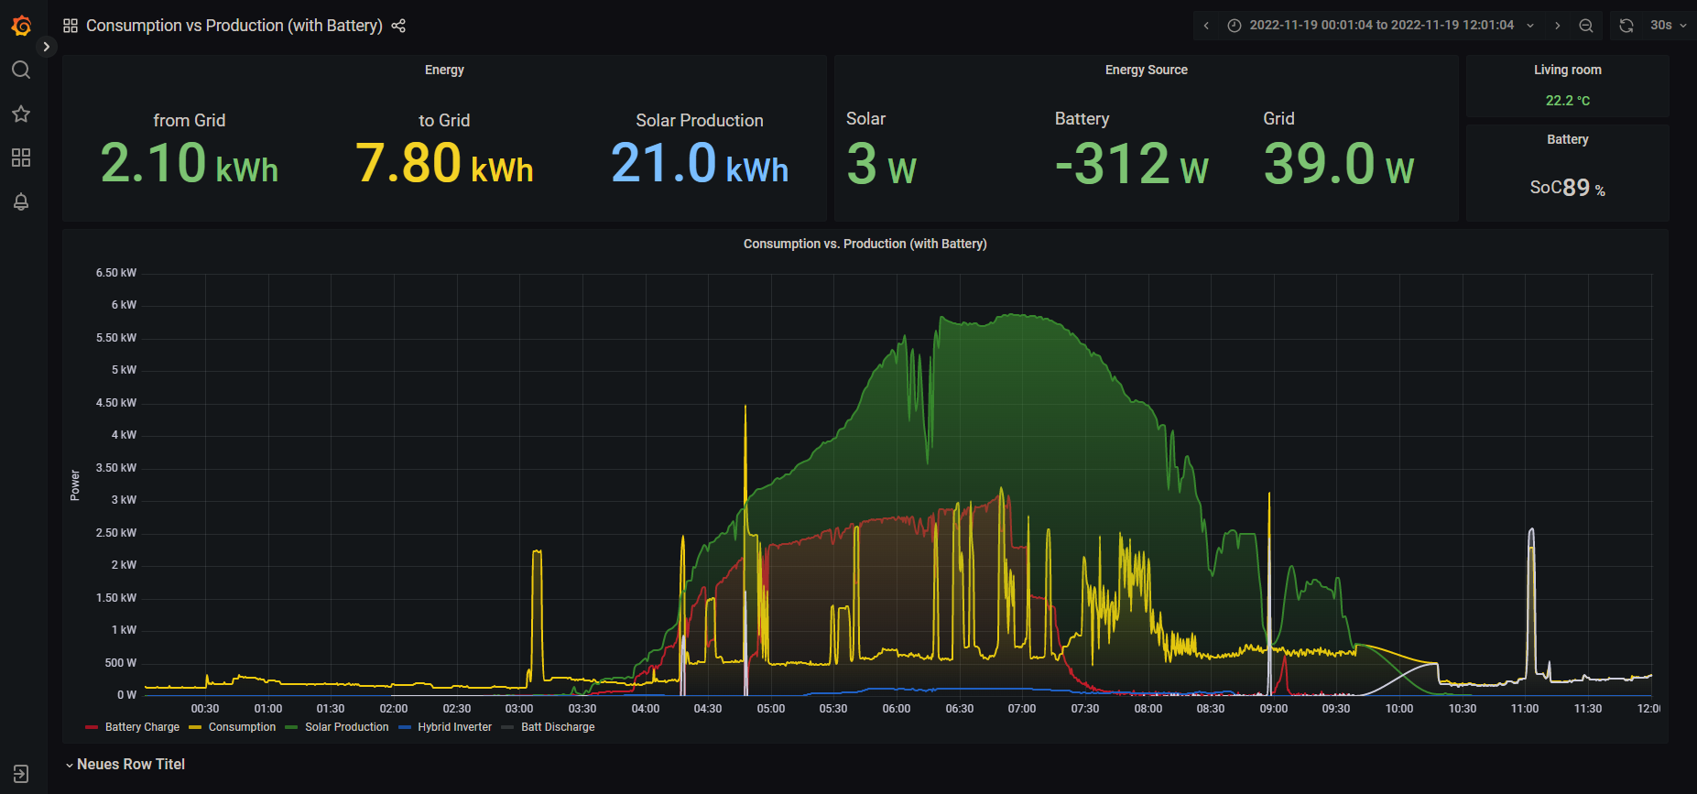
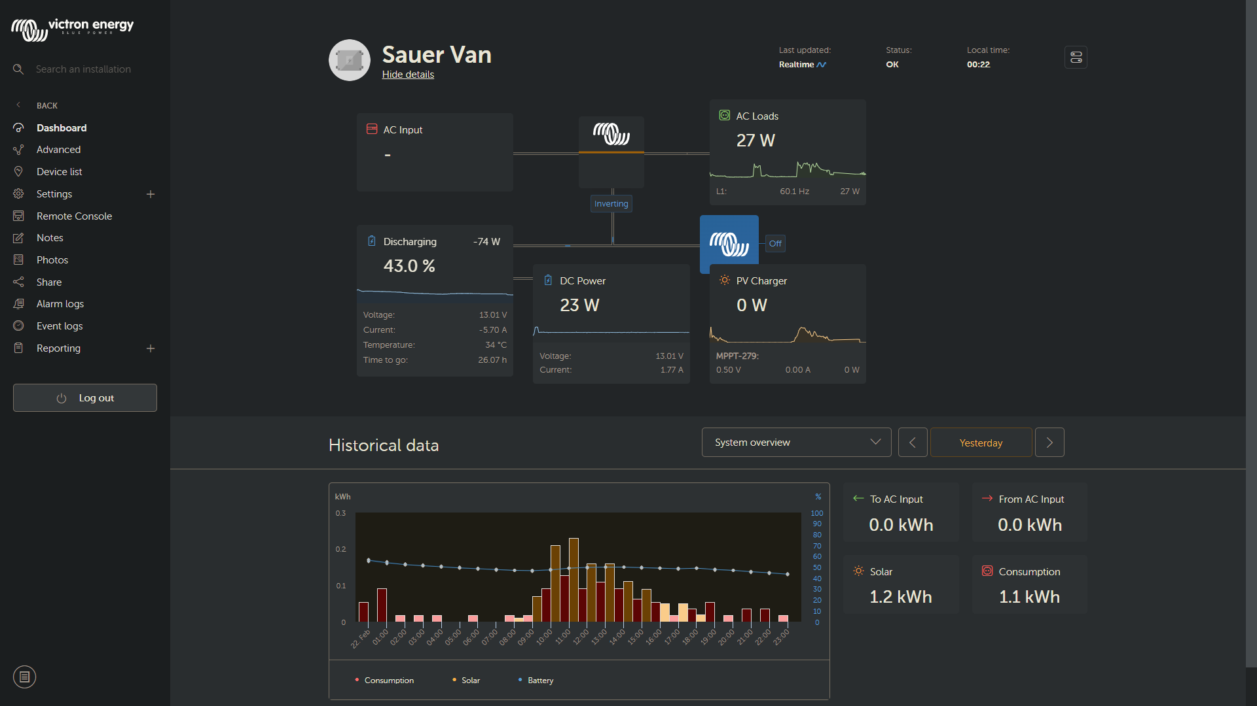
Energy Meter Data
Existing Meters have API’s to export metering data
Victron
Schneider (Wiser Energy)
Steamaco

Slide 5
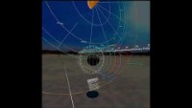
Sundial
Start with Daily Energy Data
Solar Yield
Battery Charge Cycles
Customer Usage
Weather Data

Slide 6
Questions
?

Slide 7
Circaevum – Tech Stack
Data Pipeline
Build Environment
Product
Google OAuth
Unity Game Engine
Circaevum
App
Circaevum Mapping System
Apple OAuth
Game Server Client
Core Time Structure
PostgresDB
Login Menu
Interaction Manager
User Data System
Event-Object Rendering System
Game Server
OAuth Tokens
OAuth Tokens
Static Event-Objects
Static Event-Objects
Sundial
App
Victron OAuth
Multiplayer System
Dynamic Event-Objects
Dynamic Event-Objects

